Slide 1
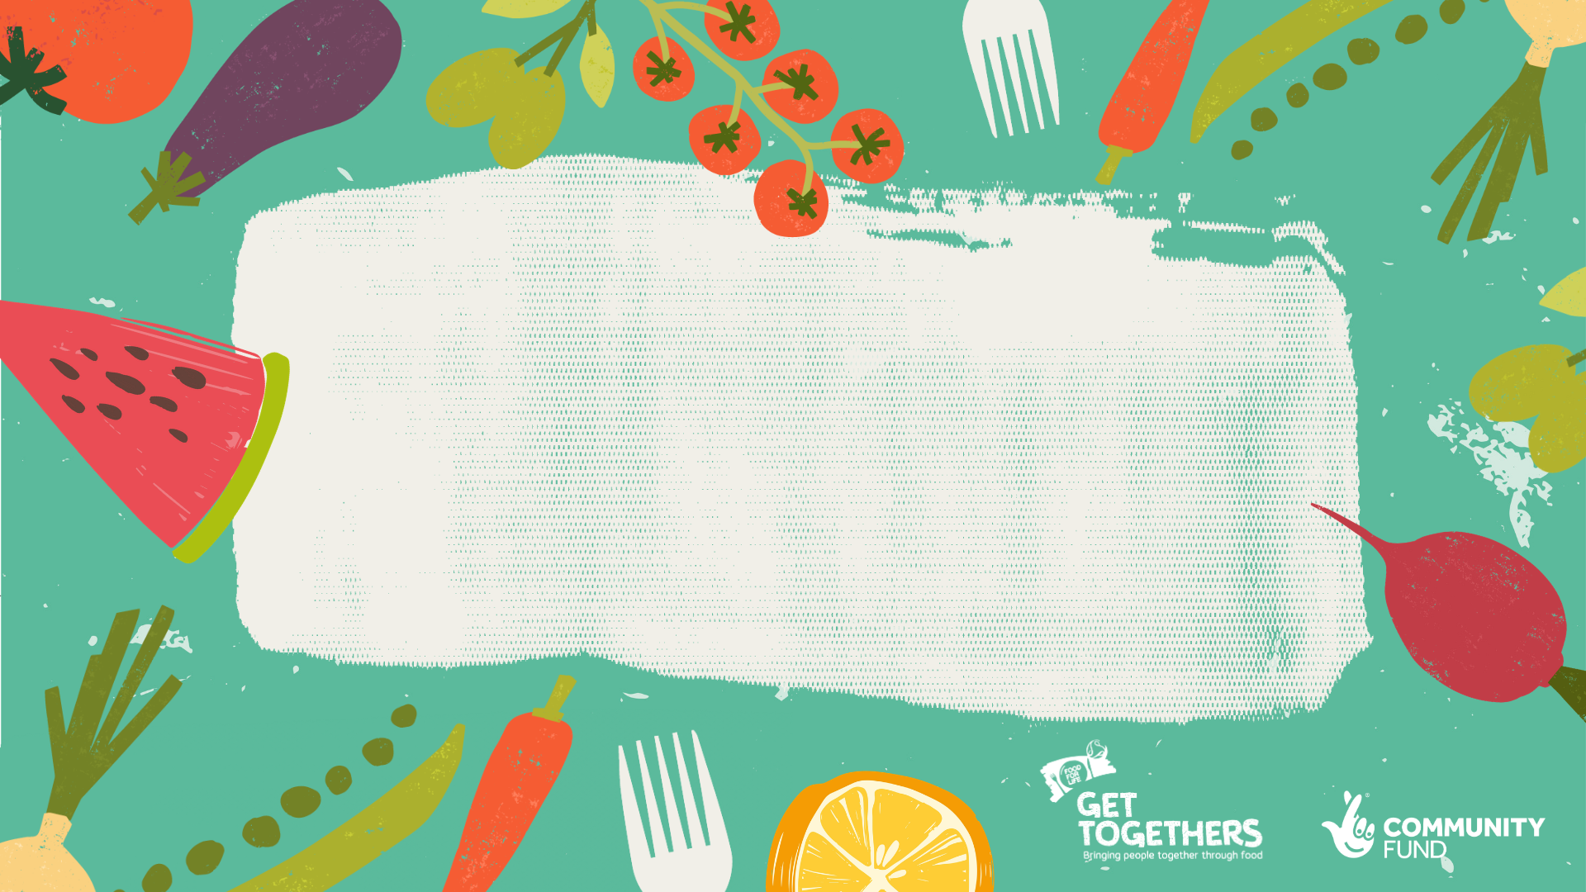
Eating Well From Birth: Good food work with early years, children and families
B arts| Stoke-On-Trent Mother’s Support Network
Online Network Session 7th April 2022

Slide 2
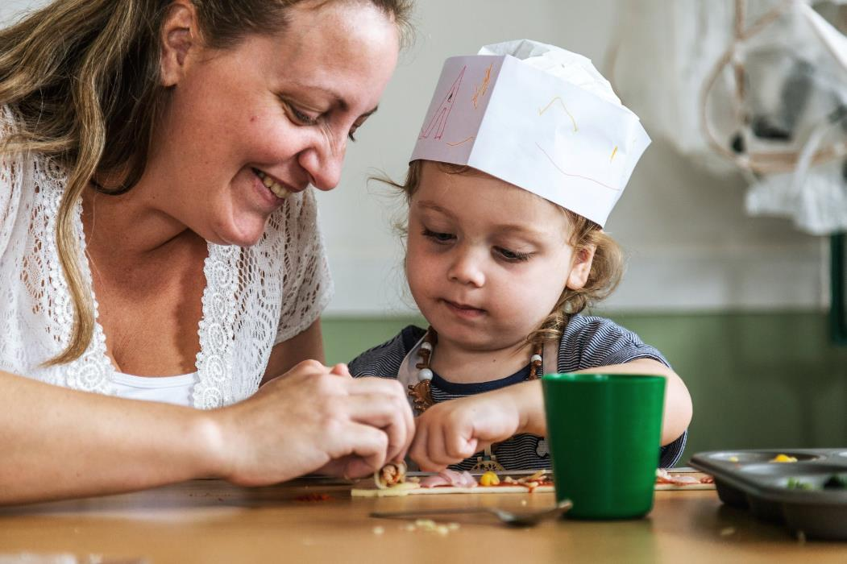
Eating Well from birth
Good food work with early years, children, And families

Slide 3
Introduction: B aRts
B arts are an arts and community organization based in Stoke-On-Trent (North Staffordshire) www.b-arts.org.uk
We run a community supported bakery and surplus food café (Bread in Common) www.breadincommon.com
We run a lot of projects with our communities that are around eating well together (Chatty Café, Climate Café, Space to Connect, Fareshare Delivery, Little School) and we like to include eating together in everything we do!
All our work is collaborative—with communities, organisations, activists.

Slide 4
IntroDuction: Stoke-On-Trent Mother’s Support Network
Stoke-On-Trent Mother’s Support Network https://sotmums.com
It takes a village: Stoke Mums we work on connections, community, and networking. We like to provide the spaces where people can meet, whether it’s online or face-to-face. We began as a group of mums meeting in the park during lockdown and realised that together we can make a difference.
Through our determination and drive we have now created a network of support throughout the entirety of Stoke-On-Trent and if we can’t help you then we know someone who can!

Slide 5
During this section we will…
Give 4 examples of projects/activities that B arts and Stoke On Trent Mums have run
Each example will include; How we engage parents/children
Models for peer led activity
What we’ve learned
How to build partnerships/support and keep activity going
Time for questions/discussion
Break out rooms

Slide 6
Child/family led cooking workshops exploring ways to cook and eat together (B arts)
Holiday-based family and child led cooking project running since 2016
It started from talking to children and families we met in libraries, and from working with families at children’s centres and nurseries (and from personal experience) (this helped us come up with the idea and plan practicalities)
We started small to try out ideas with children and families
Although issues like holiday hunger and holiday slump/low literacy in part prompted the activity the emphasis is on working with children and families to create an exciting food, cooking and eating experience. Exploring new foods and ways for children to take the lead on making their own meal to share

Slide 7
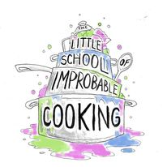
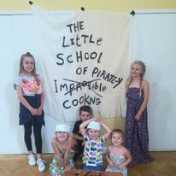
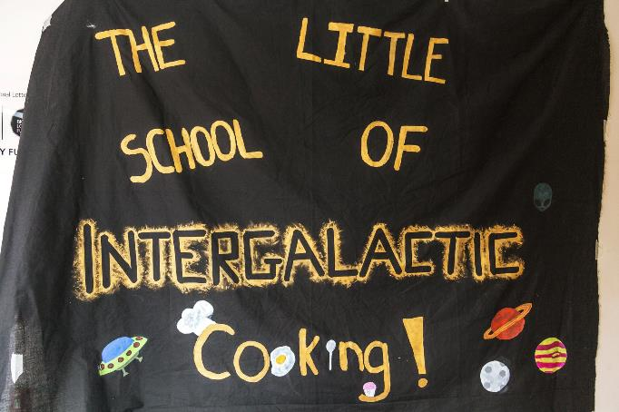
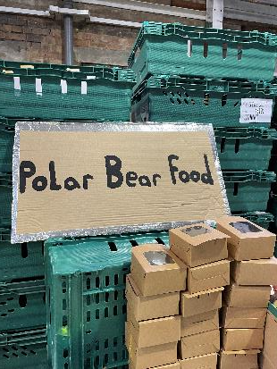
How it works
We set a simple magical challenge/story to get the children excited/engaged (we’ve lost a dragon & we need to tempt them back with food, or the colours are fading we need to make rainbow food to bring them back): we need the children ‘little chefs’ to help by cooking
Or we use a book; The Little Red Hen; Stone Soup; The Runaway Pancake; The Rascally Cake; Magic Pasta Pot; The Gruffalo; Jack and the bean stalk etc

Slide 8
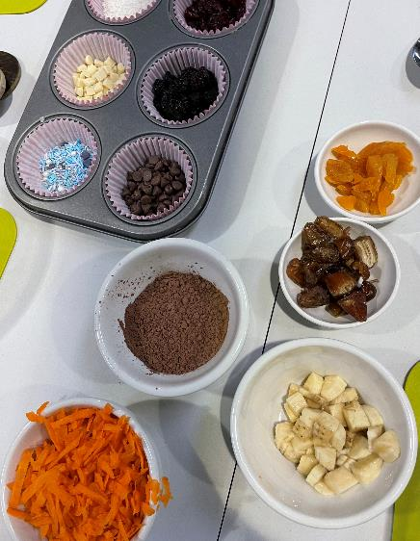
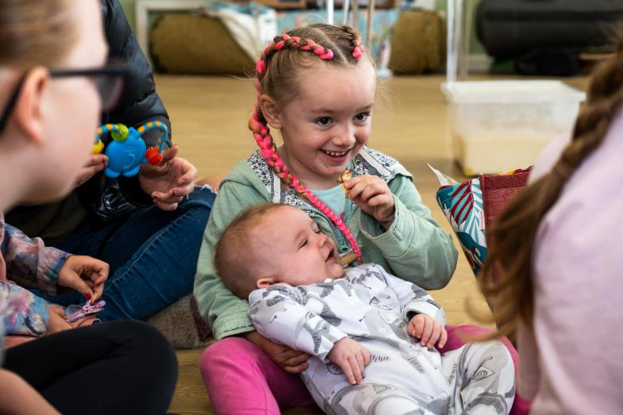
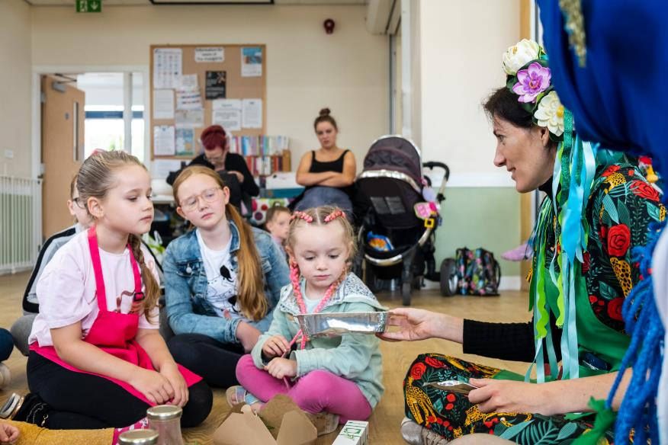
Treasure hunt for ingredients We taste and explore
We start with a treasure hunt to find mystery ingredients (we lost our boxes of ingredients. they look like this can you help us find them)
We try to choose unusual things/ things in season and things used for the recipe; e.g. things we have used include Seaweed, Chia/Citron Seeds, Nettles, Passion Fruit, Petals, dates, Fresh herbs, cockles, wheat)

Slide 9
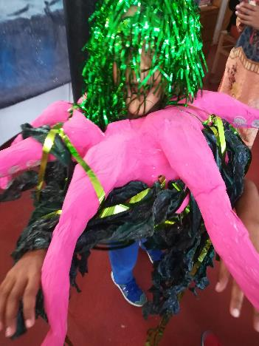
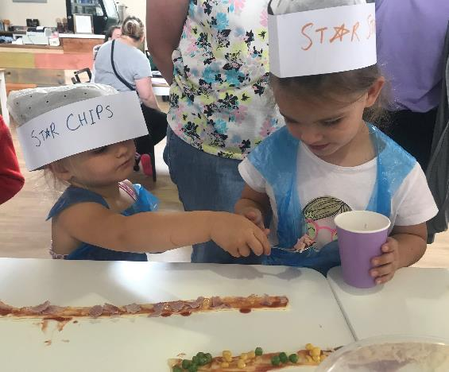
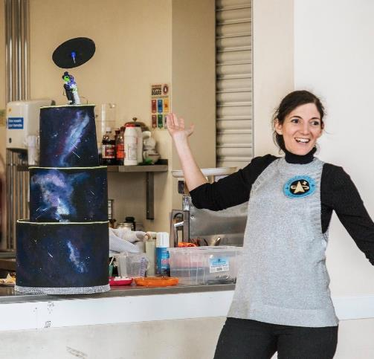
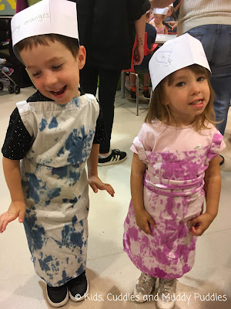
We dress up
We use paper forager hats for the children (they write or draw their favourite food as their chef name) and they have aprons
We dress up too, often the story is about a surprise visitor that the children dress up as

Slide 10
We plan cooking ideas that:
Let you explore different ingredients
Make a picture/ tell a story
Are tactile
Can be broken down into steps, that support children to take the lead (for example—pre cooking potatoes and letting them cool first/ what can be shaped by hand/ ripped instead of chopped etc)
That fit with cooking facilities (including outside/ in libraries/community centres with no cooking facilities)
That are adaptable for allergies/ dietary requirements
Pinterest a great place to get ideas for magical looking food! (seaside themed kids food/ party etc)

Slide 11
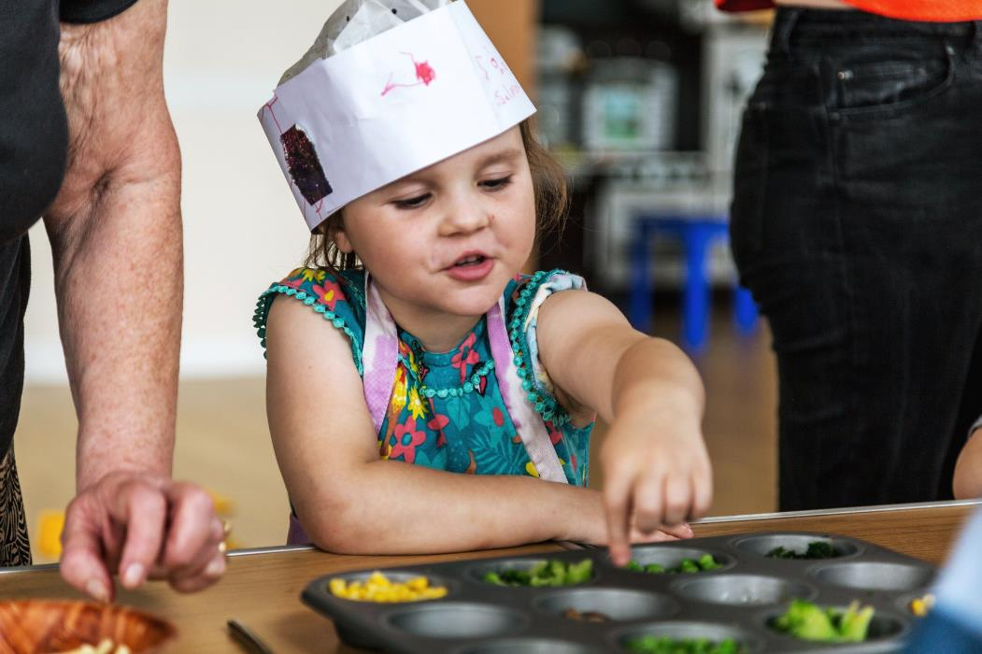
We prepare a main and dessert (that allows children to choose ingredients, and is playful)
Pirate Swag Bags
Galaxy Swirl
Rainforest Focaccia
Fairy Garden pastry
Treasure Map Pizza
Alien life form trifle
Dragon Egg Buns
Seaside Dessert

Slide 12
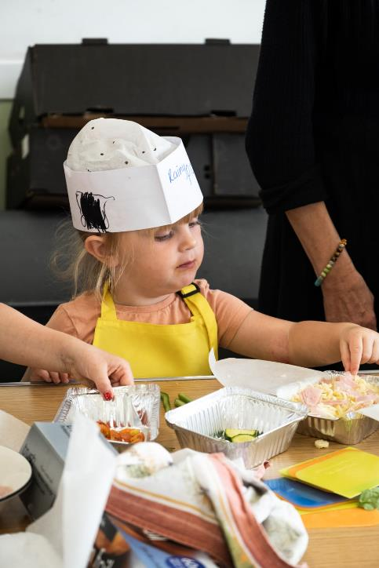
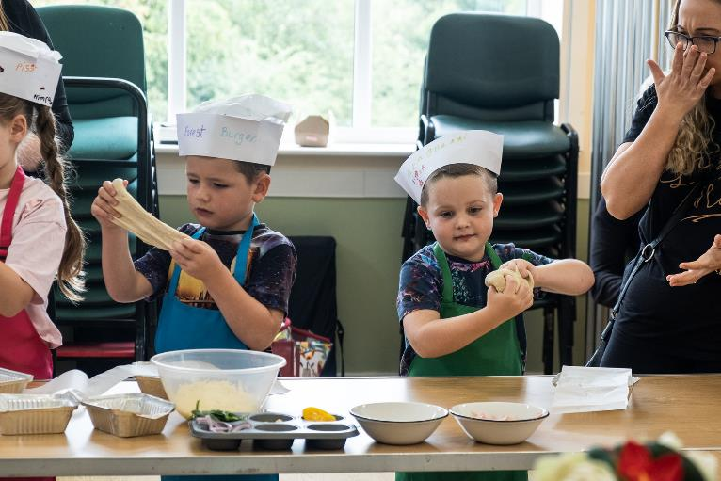
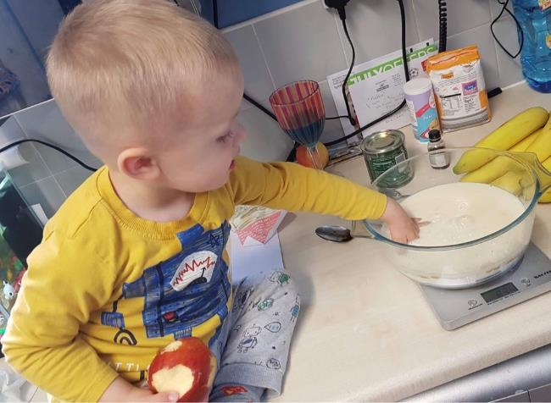
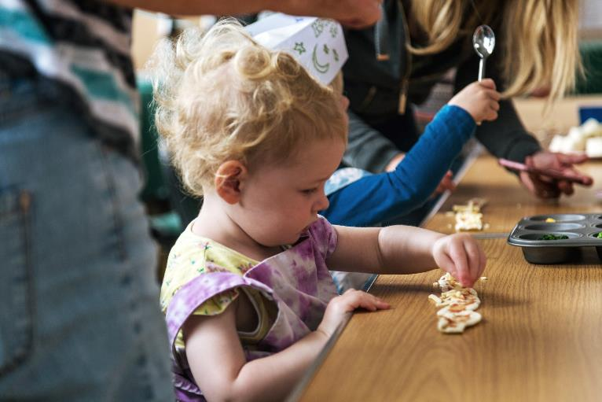

Slide 13
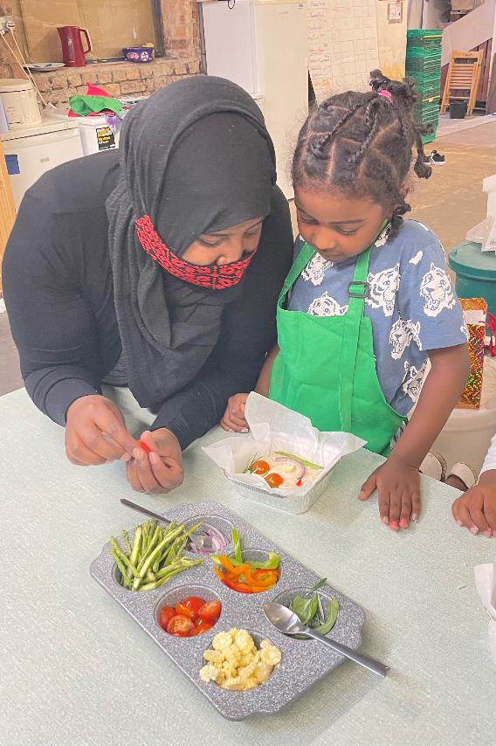
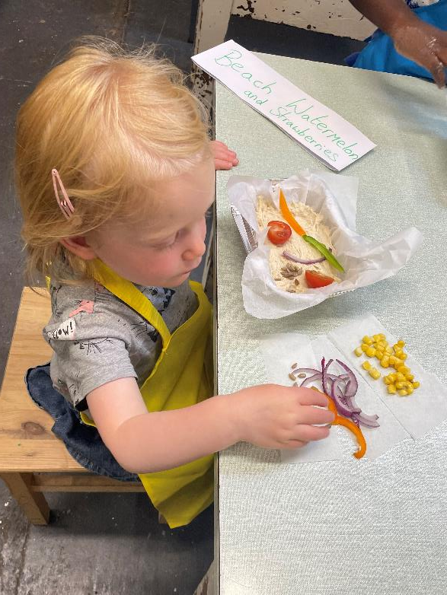
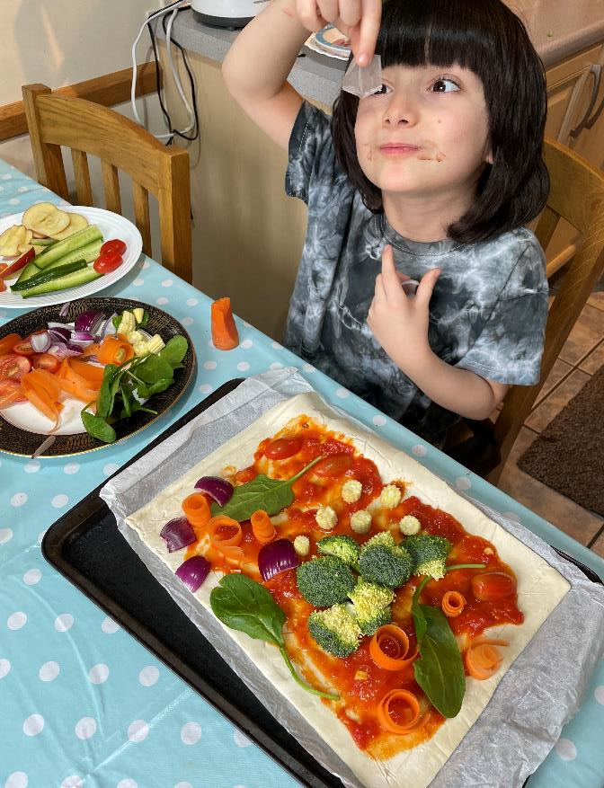
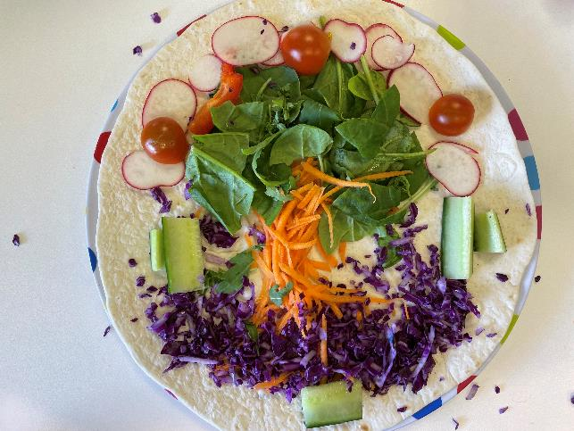
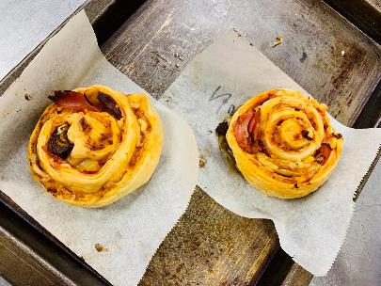

Slide 14
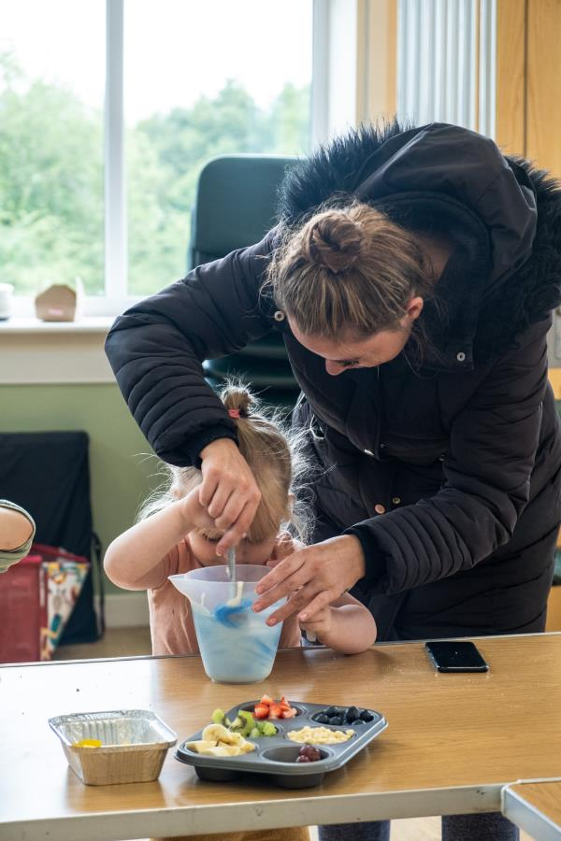
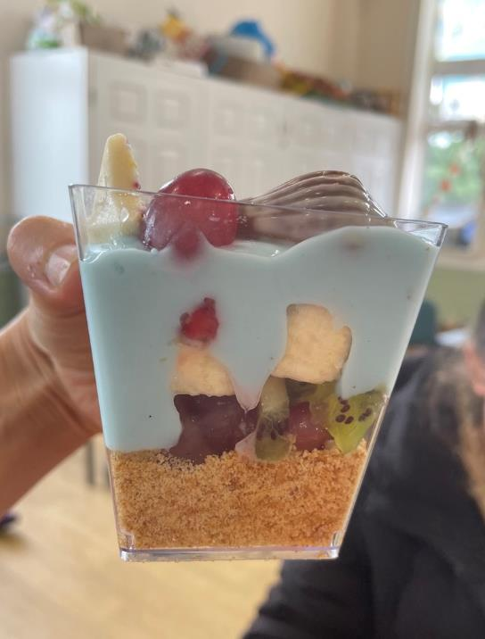
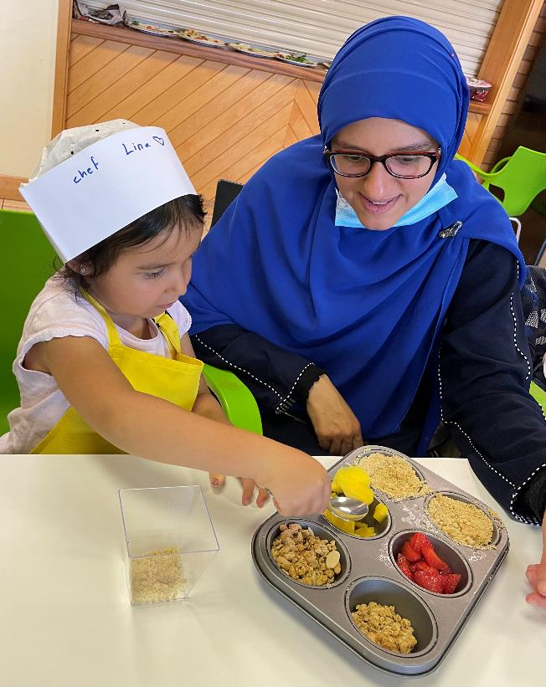

Slide 15
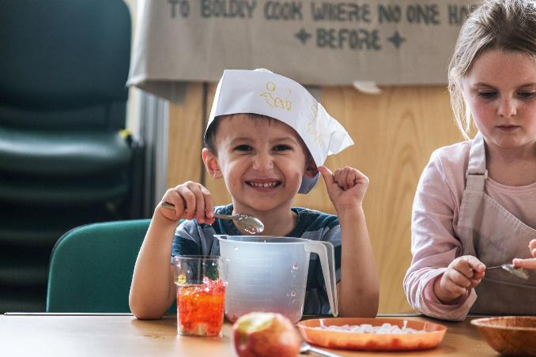
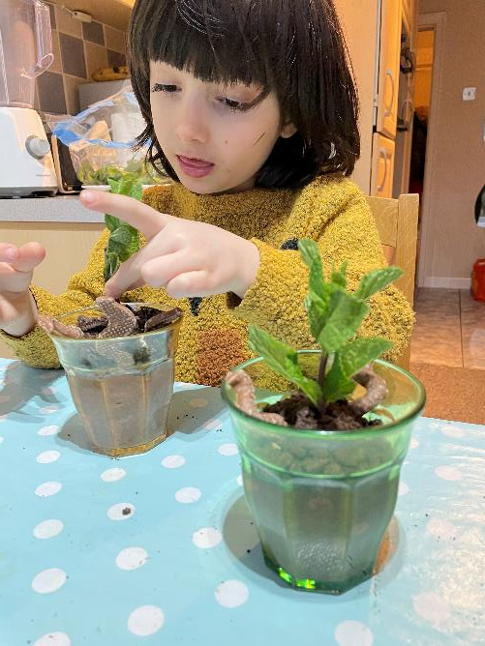
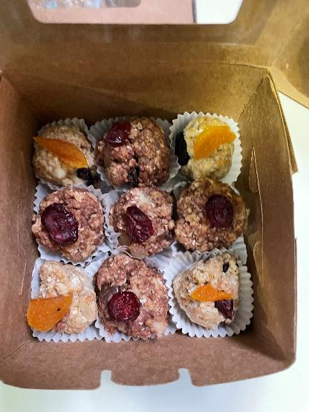
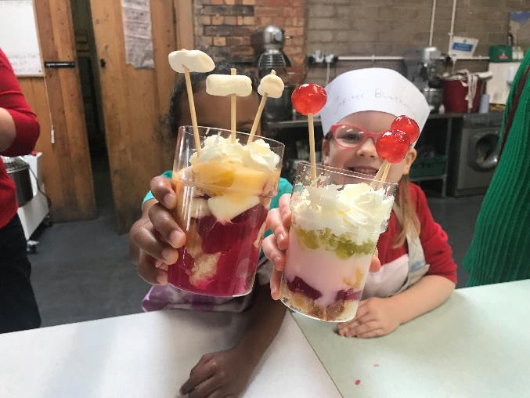

Slide 16
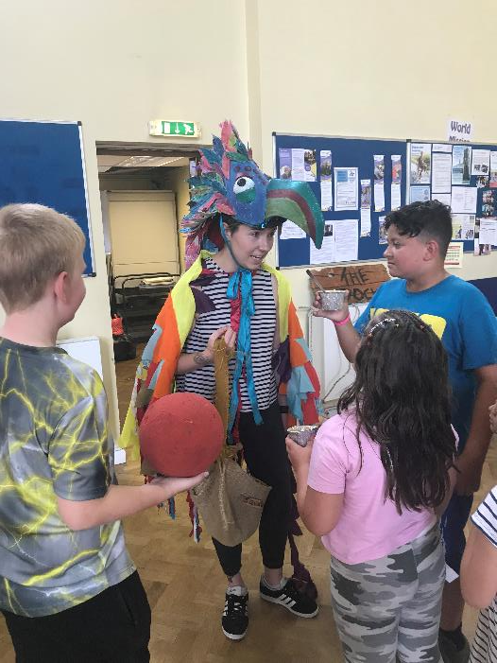
We eat together and end the story

Slide 17
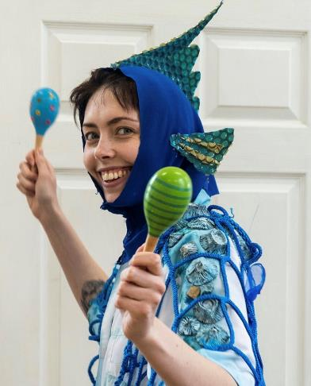
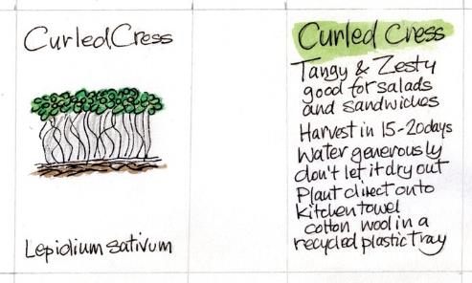
Extras
Over summer holidays we link with the reading challenge (and library service adds to the session). We often do a call out for donated children’s books (run a book swap/ gifting alongside the session)
We often add related craft activities and songs/rhymes/actions (especially if what we are making needs time to cook/bake)
We link to a theme or a book (it helps us shape ideas and the kids to get excited)
We’ve also linked to different time periods (Roman, Ancient Greece, Fire of London) or holidays/festivals
We eat together at the end and each child gets a thank you token
(seed paper medal/ packet of cress/ chocolate coin)

Slide 18
Keeping it going/ partners
Library service (we meet in libraries) or when it’s a neighbourhood with no library we have a box of books/ little library van
Community venues (churches, community centres, events, schools, nurseries, in the park/ on car parks)
Parent network (child minders/bloggers/ home school network/ teachers)

Slide 19
The Kitchen // Munch and Mingle (B arts)
Peer led cooking sessions and socializing for parents/grandparents (weekday morning after school drop off)
Each week a different ‘guest chef’ takes the lead on sharing a recipe
Participants cook together then either take it away or stay and eat together.
Based on the interests of the group (so has including sharing recipes traditional/from childhood)
English for speakers of other languages with a food focus and peer support in finding ingredients/ substitutes

Slide 20
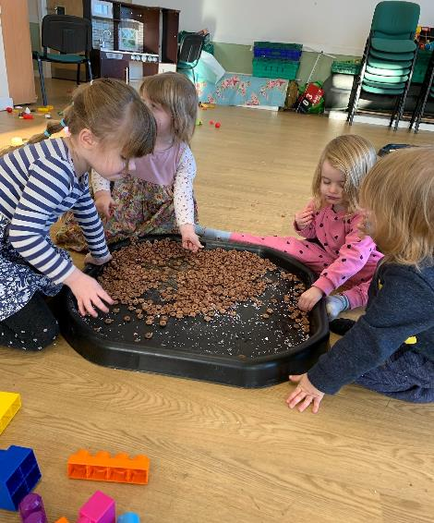
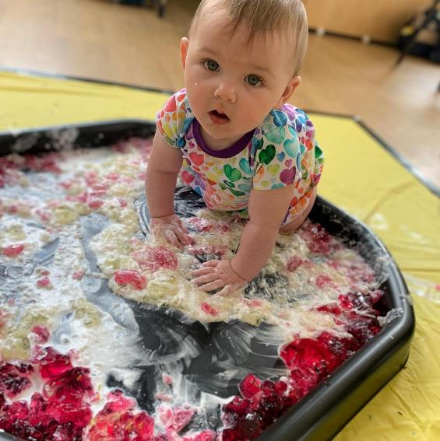
Q and A with SOT Mums

Slide 21
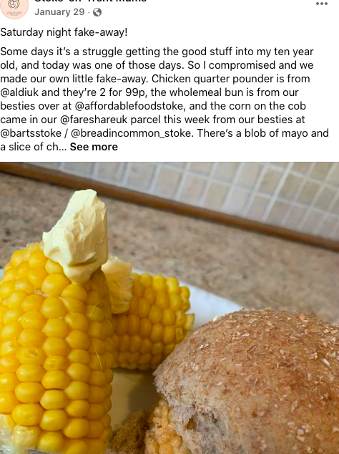
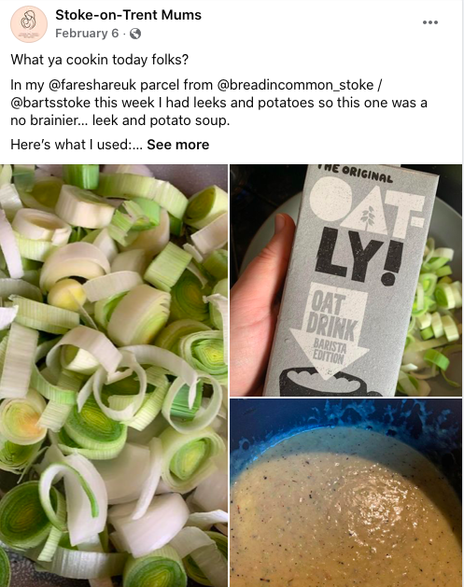
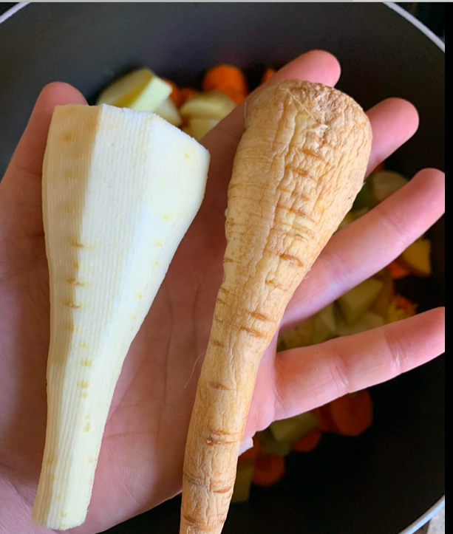
How Do I?
Building a peer support network for getting started with cooking and sharing cooking and food skills

Slide 22
Messy lunches and food based messy play
Café based meet up for parents and babies, that combine exploring new foods with messy play activities
Messy play sessions that include exploring different foods!

